Slide 1

CYBERMINER
Project II: Final Presentation
Fareen Chowdhury, Ross McNew, Midhat Wahab

Slide 2

OUTLINE
Introduction
Definitions
Functional Requirements
Non-Functional Requirements
Architecture Style
Rationale
Conclusion

Slide 3

INTRODUCTION
Goal: To create a search engine that accepts a list of keywords and returns to the user a list of URLs and descriptors that closely match the input.
Cyberminer - Searches through given database
Noise Words - words that are not crucial or are used too often to be considered important to the search
Noise Word Eliminator - removes noise words before search is conducted
KWIC System - Key Word In Context (described later)

Slide 4
INTRODUCTION (cont’d)
KWIC - User inputs alphanumeric data within a specified word limit
Circular Shift Function - Function where the first word of the input is removed and appended to the end, repeatedly
Alphabetizer - Lists the output of the circular shift function in alphabetical order

Slide 5


ACRONYMS AND DEFINITIONS
KWIC | Key Word in Context
CYBERMINER | Web Search Engine
CIRCULAR | Cyclic Pattern
SHIFT | Incrementing/Decrementing
INPUT | User-given data
ALPHABETICAL | Relating to the alphabet’s order
DESCRIPTOR | Text and URL that leads to the page the text describes
URL | List of strings predefined as having the template: ‘http://’ identifier ‘.’ identifier ‘.’ [‘edu’ | ‘com’ | ‘org’ | ‘net’]

Slide 6

FUNCTIONAL REQUIREMENTS
Application will:
Accept keywords from the user/keyboard as input
Search through database to retrieve URLs leading to existing websites
Display search results onto the screen to the user
Display URLs to the user and allow them to click on the hyperlink to take them to the website described
Maintain the database of URLs and their accompanying descriptions
Maintain that each URL and descriptor is unique
Allow multiple web search engines to run concurrently
Run Cyberminer simultaneously with the KWIC system
Will accept strings, letters and numbers
Maintain that each URL will start with “https://” and end with a common URL extension such as “edu”, “gov”, “net”, “com”, etc
Apply a noise word eliminator that removes all noise words such as “or”, “of”, “the”, “a”, etc, for rigorous results
*Not all FRs displayed above

Slide 7


NON-FUNCTIONAL REQUIREMENTS
Application will:
Be Understandable User should understand easily what they should do
Be Portable Web Search Engine should be compatible on any device and on any browser
Be Enhanceable Program should depend on large-scale components, easily adjustable without changing other modules
Be Reusable Modules and functions should be able to be used by other components
Have Good Performance Noise Word Eliminator should increase the overall performance by decreasing redundancy
Be User-Friendly Display results clearly and allow the user to take action by clicking on the hyperlinks or allow the user to start a new search
Be Quick To Respond System should take no longer than 3 seconds
Be Familiar Search Engine should resemble existing search engines in a way to allow ease and familiarity to the user

Slide 8

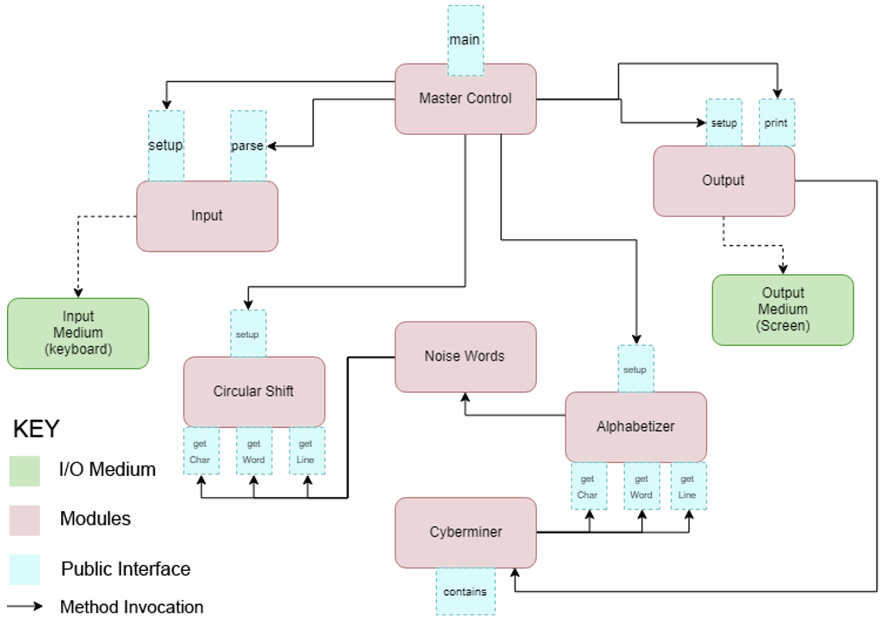
ARCHITECTURE STYLE: Abstract Data Type

Slide 9


ARCHITECTURE STYLE
Rationale
ADVANTAGES
DISADVANTAGES
Understandable - Easy to follow along, each module distinct
Scalable - Any new requirement can be easily implemented without changing much
Reusable - Code can be used in other methods
Space - A lot of space will be used, as multiple component will require a copy of the user-given data
Response Time - the response time will also be affected because of space and how each module has to be built up
Notes:
Talk abt other considered styles such as MVC and pipe and filter: advantages and disadvantages

Slide 10

Conclusion
Future Work
GITHUB LINK: https://github.com/fareench/CS_4352_Project_1
WEBPAGE LINK:
http://www.utdallas.edu/~rlm160030/search_engine.html
QUESTIONS?

